Slide 1

DAYANANDA SAGAR COLLEGE OF ENGINEERING
Malleshwara Hills, Kumarswamy Layout, Bangalore - 560111
Department of Information Science and Engineering
Smart Traffic System
Mini Project SEE
Batch No. B33
Presentation By
Anagha R (1DS22IS017)
Suvan Banerjee (1DS22IS168)
Vaibhav S Magadum (1DS22IS177)
Vedant Rajendra Balpande (1DS22IS181)
Under the Guidance of
DR. Varaprasad B K S V L
(Prof, Dept. ISE, DSCE)

Slide 2

ABSTRACT
The optimization of the existing traffic light system represents a critical step toward mitigating urban traffic-related issues. By integrating advanced methodologies and technologies discussed in [1], we aim to alleviate the challenges posed by the conventional traffic control system. The inadequacies of the current system become evident in its limited adaptability to real-time traffic conditions and its lack of consideration for various factors such as traffic volume, patterns, and emergency vehicle prioritization. This deficiency leads to prolonged travel times for commuters and jeopardizes the timely response of emergency services, potentially endangering lives. Our project introduces a dynamic traffic management approach, utilizing real-time data to adjust signal timings according to the changing traffic density. By doing so, we anticipate a significant reduction in traffic, shorter travel durations, and an overall enhancement in the quality of life for urban residents. The project's positive outcomes extend beyond individual commuters to encompass the broader community and local authorities

Slide 3
INTRODUCTION
Challenges of Increasing Vehicles
Growing number of vehicles on the road.
Necessity to manage traffic flow efficiently.
Optimize existing road capacity.
Smart Traffic Management Goals:
Develop a smart traffic management system.
Objectives
Optimize traffic flow.
Reduce congestion.
Minimize travel time.
Issues with Traffic Signals:
Traffic signals can lead to safety concerns:
Potential deterioration in overall intersection safety.
Possibility of deadlock situations.
Frequent signals in metro and densely populated cities disrupt traffic flow.
Time-Based Traffic Control:
Current automated traffic control systems often use time-based algorithms.
Each lane receives a fixed time for traffic clearance.
Times may be equal for all lanes or based on vehicle density.

Slide 4
MOTIVATION
The motivation behind embarking on this project is multi-faceted, stemming from both personal and societal aspirations.
Motivation for the Project:
Personal and societal aspirations drive our project.
Leveraging technology, to address urban challenges, such as traffic problems.
Key Reasons for Enthusiasm:
Exploration of AI and Applied Machine Learning.
Focus on computer vision and object detection.
Target: Solving urban challenges, especially traffic issues.
Real-world Application of Technical Skills.
Applying theoretical knowledge practically.
AI-based traffic management for a meaningful impact on city residents.

Slide 5
PROBLEM DEFINATION
Developing a smart traffic management system to optimize traffic flow, while minimizing the travel time and maximizing mobility. The problem at hand is to design and implement a solution that effectively reduces traffic congestion. The solution should focus on minimizing traffic delays, improving travel times, reducing environmental impact, and enhancing overall urban mobility. While making the system practical to install on real traffic signals

Slide 6
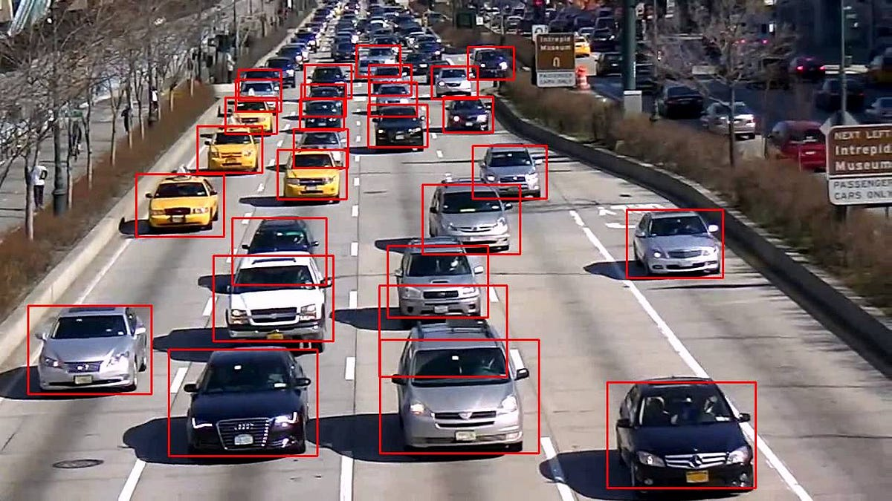
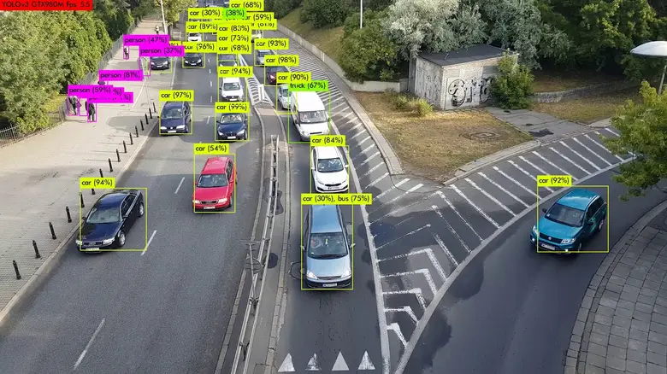
OUR SOLUTION
OBJECT DETECTION BY YOLO
YOLO, which stands for "You Only Look Once," is a real-time object detection system that is widely used in computer vision and machine learning. It's a deep learning-based algorithm that can quickly and accurately identify and locate objects within images or video frames.

Slide 7
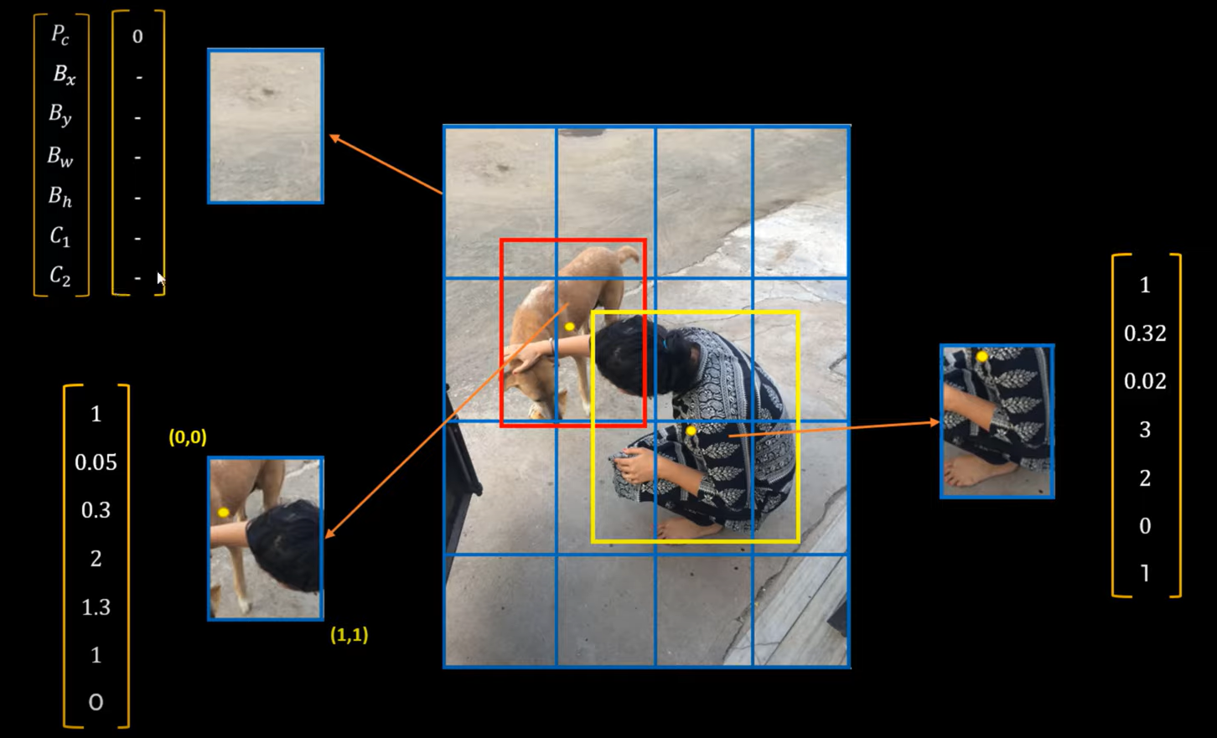
How It Works
YOLO takes an image or a video frame as input. The input image is divided into a grid, typically, a grid of cells (e.g., 19x19 or 13x13). YOLO uses anchor boxes to help predict the size and location of objects.
Prediction of size and location of object

Slide 8
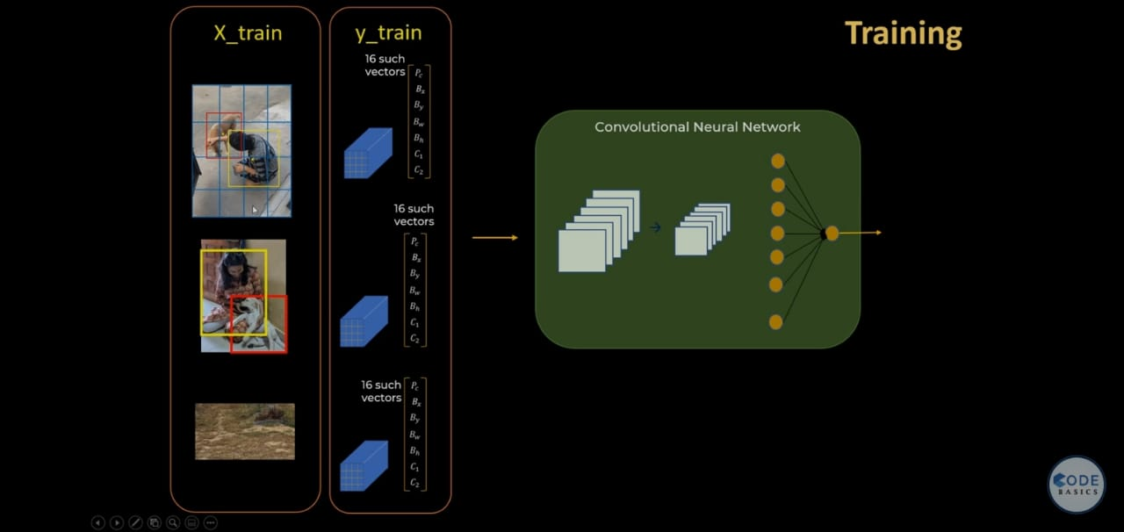

Slide 9
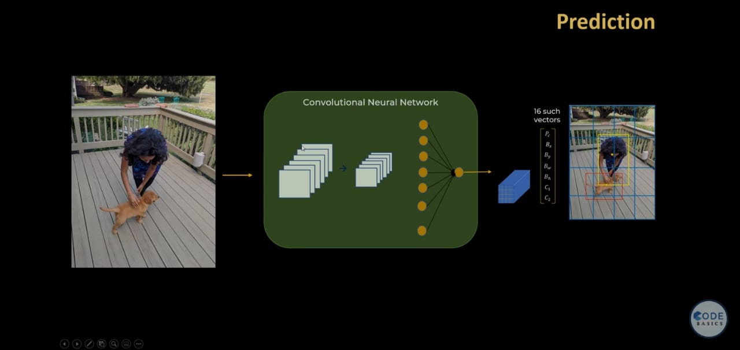
TEST IMAGE

Slide 10
CONNECTION BETWEEN DENSITY CALCULATION AND TRAFFIC
Our current solution is super simple to understand and littile bit difficult to code
Our plan is we will find out the density of each lane
Then based on the density we can have three cases
Each case has different logic and traffic management
This system is intended to run 24/7 and automatically chooses case

Slide 11
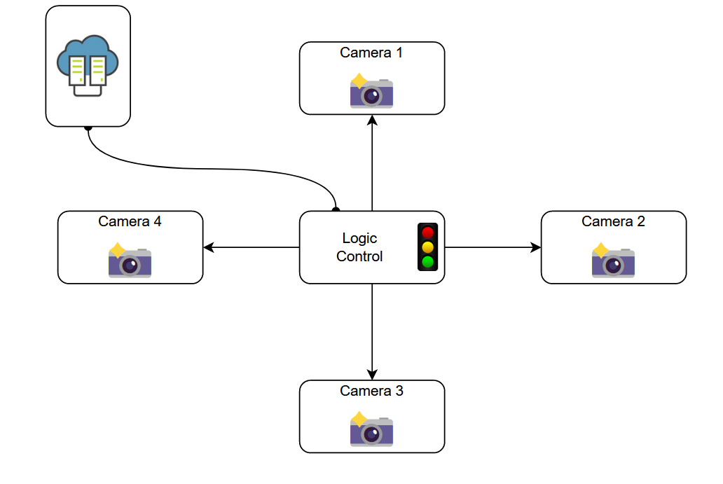
System Block Diagram

Slide 12
CASE 1

Slide 13

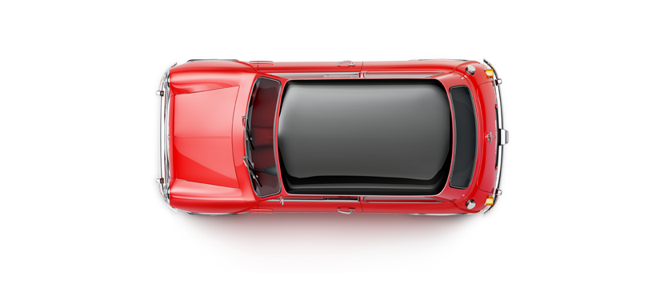
CASE 1

Slide 14
CASE 1

Slide 15
CASE 2

Slide 16
CASE 2

Slide 17
CASE 2

Slide 18
CASE 3

Slide 19
CASE 3

Slide 20
CASE 3

Slide 21
CASE 3

Slide 22
CASE 3

Slide 23
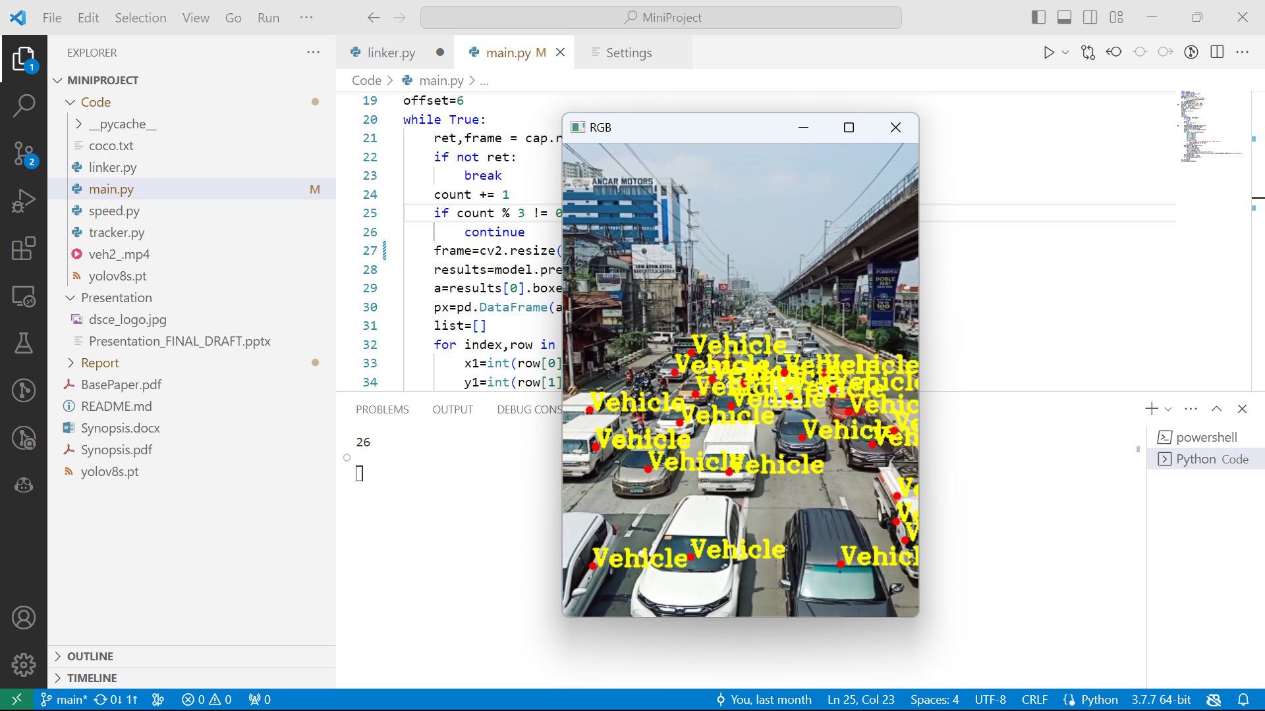
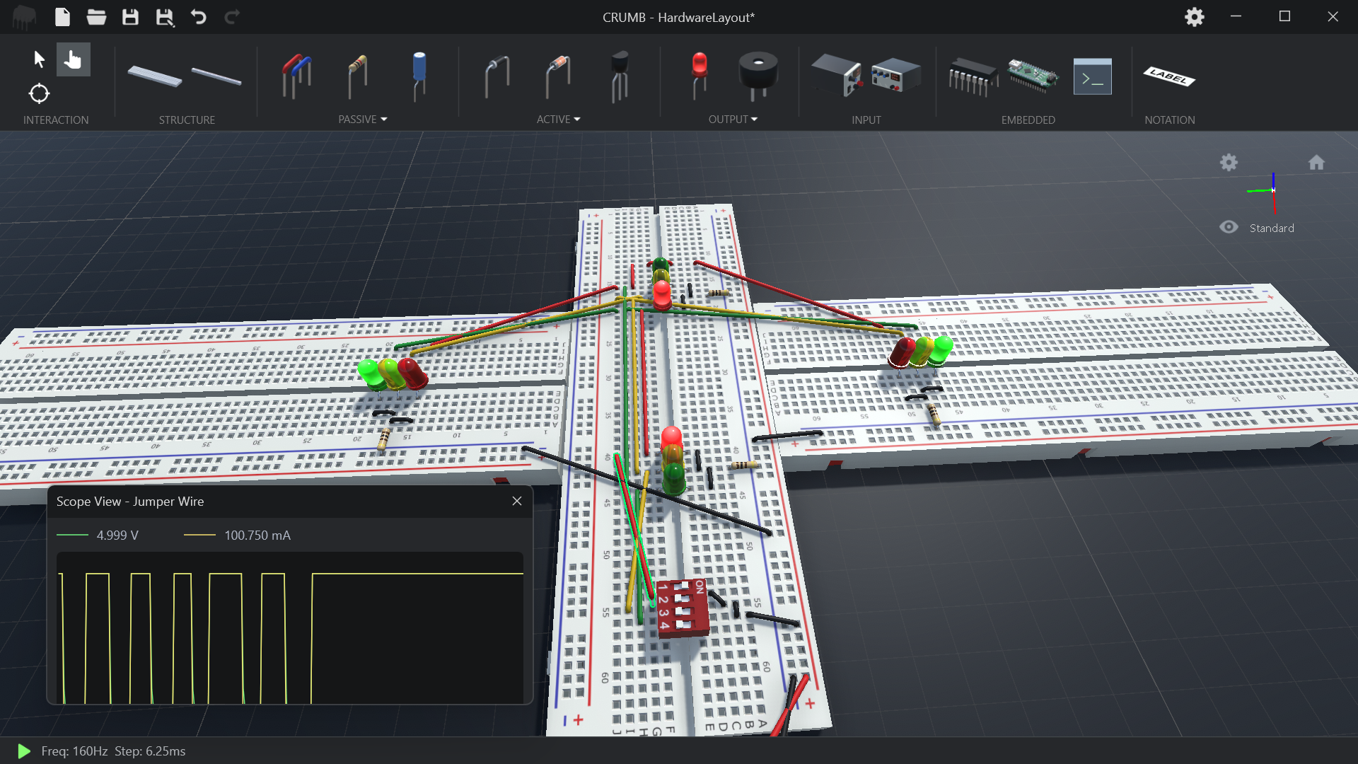
RESULTS/OUTPUT
This System reduces traffic delays and helps the traffic flow faster
It collects and logs the data to a datacentre over the network for future researches and will help to train larger AI systems to predict and manage traffic patterns
Current model is modular and don’t need to change the current system entirely it is compatible with existing systems with cctv

Slide 24
CONCLUSION
Adaptive Green Signal Timing
Adjusts green signal time based on traffic density.
Prioritizes higher traffic directions for longer green signals.
Reduces unwanted delays, congestion, and waiting times.
Improvement Over Current System
Expected significant enhancement in the number of vehicles crossing intersections.
Suitable for integration with CCTV cameras in major cities for better traffic management.
Comprehensive Solutions
Ranges from short-term interventions (optimizing traffic signal timings) to long-term strategies (sustainable transportation promotion and urban planning revisions).
Impact on Traffic Congestion
Affects travel times and productivity.
Alters pollution levels.
Influences public safety.

Slide 25
FUTURE ENHANCEMENTS
Port Scanning for Network Discovery
Implement port scanning functionality.
Actively discover and identify available network ports.
Expansion to Multiple Junctions
Scaling deployment for urban traffic management expand coverage to multiple junctions
Mutual Execution
Implement mutual execution, e.g., with a tool like Sophomore to prevent conflicts during network file writing.
Testing on Raspberry Pi
Essential to test and optimize performance.
Utilize hardware like Raspberry Pi for testing.
Improved Nighttime Accuracy
Enhancing performance during low-visibility conditions. Integrating thermal/IR cameras. For better recognition of vehicles in the dark.
Data Encryption for Network Security:.
Implement strong data encryption protocols.
Ensure encrypted transmission over the network.

Slide 26
LEARNING OUTCOMES
Project Focus Areas
Environmental Awareness
Evaluation and Analysis
Traffic Management Future Relevance
Using Work flow Tools Efficiently
Learning Experience
Participation in this project offers a comprehensive learning experience.
Encompasses technical skills, problem-solving abilities, teamwork, and understanding urban transportation challenges and solutions.
Valuable Learning Outcomes
Engaging in a traffic congestion solution project with traffic lights.
Results in several valuable learning outcomes.

Slide 27
References
[1] L. Rajendran , "Real-Time Adaptive Traffic Control System For Smart Cities," International Conference on Computer Communication and Informatics (ICCCI) (IEEE), pp. 1-6, doi: 10.1109/ICCCI50826.2021.9402597, March 2021.
[2] Sharon, G. Alleviating Road Traffic Congestion with Artificial Intelligence. In IJCAI (pp. 4965-4969), June 2021.
[3] Jiang, Peiyuan, et al. "A Review of Yolo algorithm developments." Procedia Computer Science 199 (2022): 1066-1073.
[4] Kong, Xiangjie, et al. "Urban traffic congestion estimation and prediction based on floating car trajectory data." Future Generation Computer Systems 61 (2016): 97-107
[5] Arnott, R., & Small, K. The economics of traffic congestion. American Scientist, 82(5), 446-455. 1994.
[6] Mihir Gandhi. Smart Control of Traffic Light System using Artificial Intelligence [Video]. YouTube. https://youtu.be/OssY5pzOyo0. May 2020

Slide 28
Thank You
DAYANANDA SAGAR COLLEGE OF ENGINEERING
Malleshwara Hills, Kumarswamy Layout, Bangalore - 560111
Department of Information Science and Engineering

